Slide 1
Language Models are Few-Shot Learners
Tom B. Brown et al.
July 22, 2020
https://doi.org/10.48550/arXiv.2005.14165
-Kolton Hauck

Slide 2
Background: NLP
Natural Language Technology
Natural Language Processing
Natural Language Understanding
Natural Language Generation

Slide 3
Background: Natural Language Processing
NLP
Natural Language Technology
Natural Language Processing
Natural Language Understanding
Natural Language Generation
Neural Networks (NN) → NLP tasks

Slide 4
Background: NLP Evolution
Statistical Models/Embeddings/Rules
Early NN – RNN/LSTM
NN – Transformers
LLMs
Now

Slide 5
Background: NLP Evolution
Naïve Bayes
Hidden Markov Models
Rules Based
Embeddings
Statistical Models/Embeddings/Rules
Early NN – RNN/LSTM
NN – Transformers
LLMs
Now

Slide 6
Background: NLP Evolution
Task-Specific Training Data
Model Size
Task-Specific Architecture
Statistical Models/Embeddings/Rules
Early NN – RNN/LSTM
NN – Transformers
LLMs
Now

Slide 7
Background: NLP Evolution
General Training Data
Task-Specific Architecture
‘Attention Is All You Need’
https://doi.org/10.48550/arXiv.1706.03762
BERT/GPT
Fine-tuned w/Task-specific dataset
Statistical Models/Embeddings/Rules
Early NN – RNN/LSTM
NN – Transformers
LLMs
Now

Slide 8
Background: NLP Evolution
GPT3 – (175B parameters)
General Training Data
Model size
Task-specific Architecture
Task-Specific Fine-tuning dataset
Statistical Models/Embeddings/Rules
Early NN – RNN/LSTM
NN – Transformers
LLMs
Now

Slide 9
Background: NLP Evolution
GPT3 – (175B parameters)
General Training Data
Model size
Task-specific Architecture
Task-Specific Fine-tuning dataset
Statistical Models/Embeddings/Rules
Early NN – RNN/LSTM
NN – Transformers
LLMs
Now

Slide 10
Zero/One/Few-Shot Learning
Transfer Learning
Reduces the need for task-specific fine-tuning datasets
Prompt Engineering
Give zero/one/few basic examples (Questions/Answers)

Slide 11
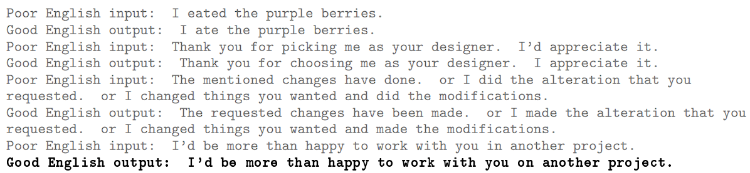
Few-Shot Learning Example
Gray: Prompt
Black: Model response

Slide 12
The Paper
Brown et al.:
Evaluated GPT-3’s performance using Zero/One/Few-shot learning against other Models fine-tuned for specific tasks
Evaluated how increasing parameters increases Zero/One/Few-shot learning capabilities

Slide 13
Why?
Use LLM + Few-Shot Learning -> Clinical Tasks
Diagnosis Related Groups (DRG) determination
Clinical Documentation
Medical Coding
Clinical Decision Support
Synthetic Data Generation

Slide 14
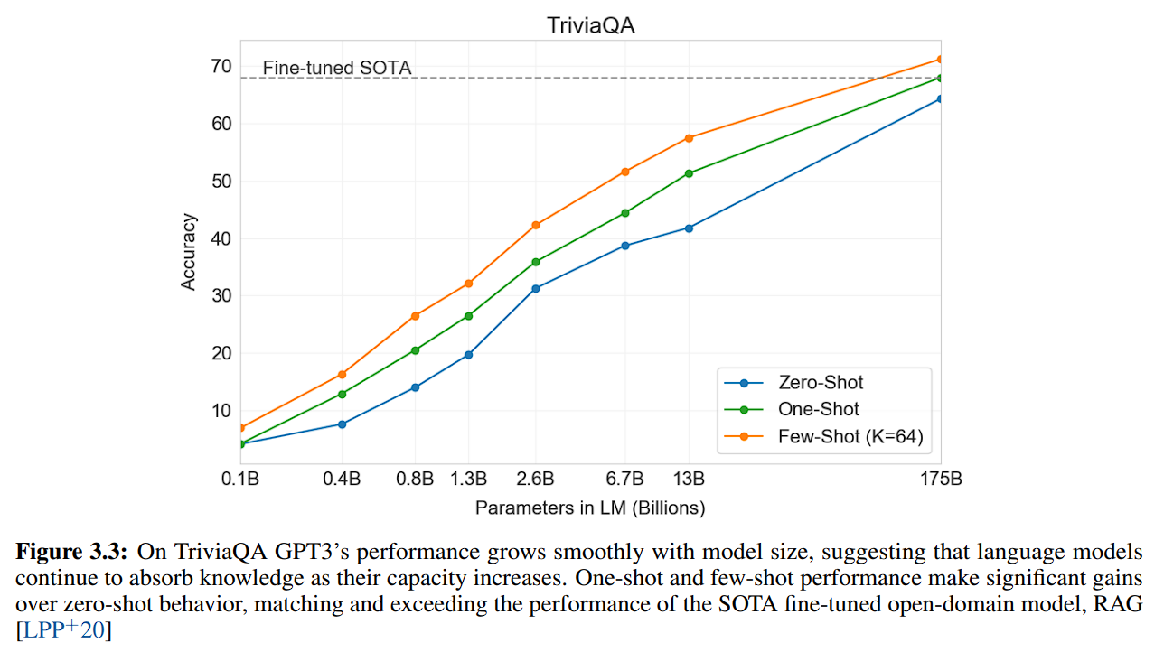
Results
Question-Answering (QA)
Conversational QA (CoQA)
Model Generated Detection
Cloze & Completion

Slide 15
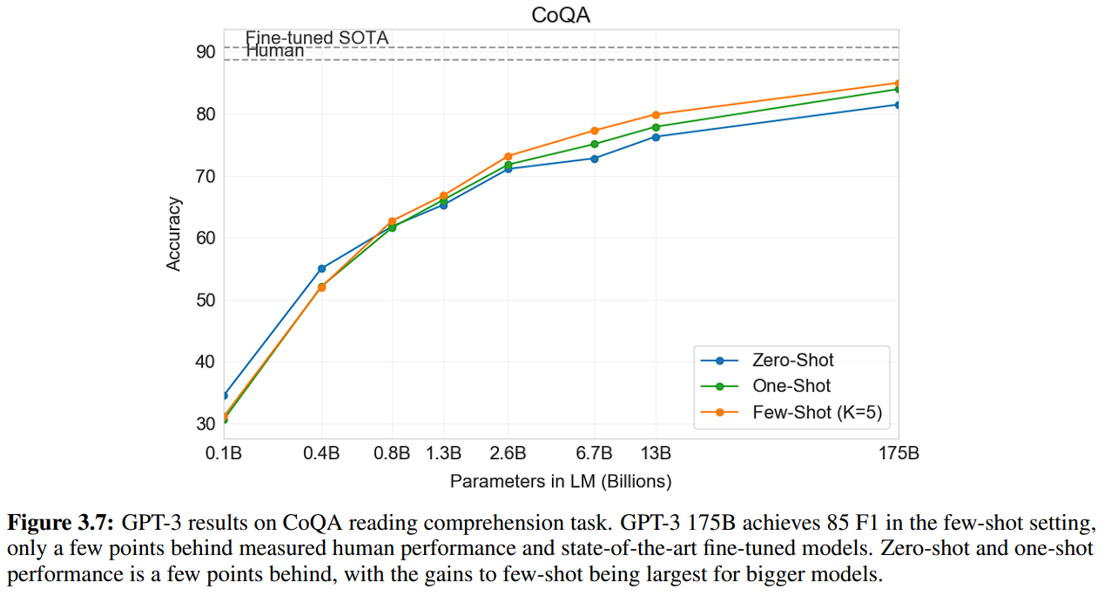
Results
Question-Answering (QA)
Conversational QA (CoQA)
Model Generated Detection
Cloze & Completion

Slide 16
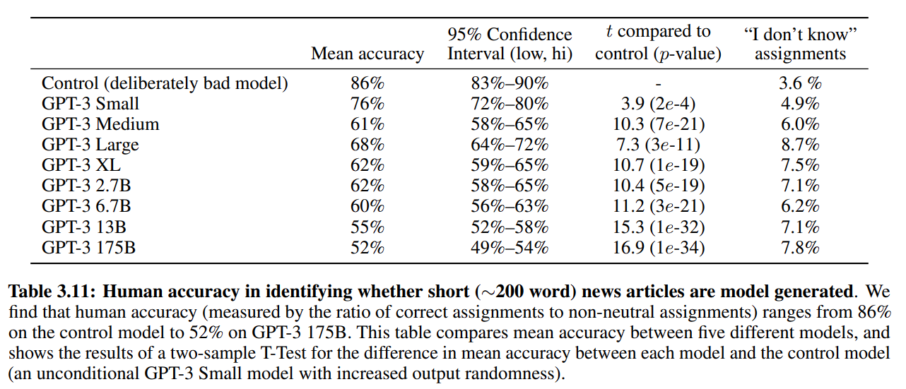
Results
Question-Answering (QA)
Conversational QA (CoQA)
Model Generated Detection
Cloze & Completion

Slide 17
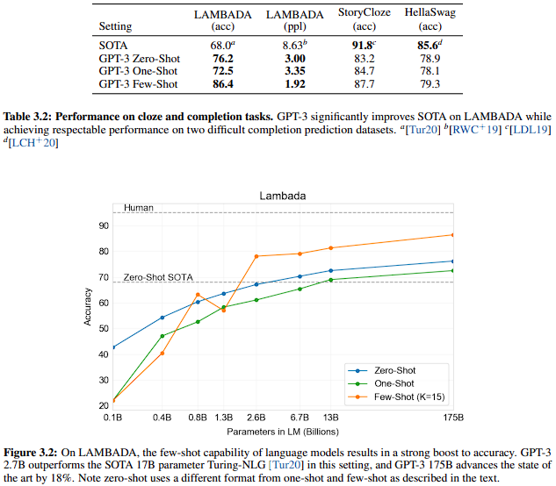
Results
Question-Answering (QA)
Conversational QA (CoQA)
Model Generated Detection
Cloze & Completion

Slide 18
Future Work – Now?
PALM
PALM
AWS Generative AI
BARD
GPT-3
LLaMa 2
GPT-3.5
GPT-4
Artificial General Intelligence?
‘Sparks of Artificial General Intelligence: Early experiments with GPT-4’
https://arxiv.org/pdf/2303.12712.pdf

